Slide 1


Zihao Gu
2025.01.09

Slide 2
Outline
1. Executive Summary
2. Introduction
3. Methodology
4. Results
5. Conclusion
6. Appendix

Slide 3

1. Executive Summary

Slide 4
1. Executive Summary
Summary of methodologies
1. Data Collection
2. Data Webscraping
3. Data Wrangling
4. Exploratory Data Analysis with SQL
5. Exploratory Data Analysis with Data Visualization
6. Building an interactive map with Folium
7. Building a Dashboard with Plotly Dash
8.Predictive Classification Analysis
Summary of all results
Exploratory Data Analysis results
Interactive analytics demo in screenshots
Predictive analysis results

Slide 5
2. Introduction

Slide 6
2. Introduction
background and context
SpaceX is the most successful company of the commercial space age, making space travel affordable.
The company advertises Falcon9 rocket launches on its website, with a cost of 62 million dollars; other providers cost upward of 165 million dollars each, much of the savings is because SpaceX can reuse the first stage.
Therefore, if we can determine if the first stage will land, we can determine the cost of a launch. Based on public information and machine learning models, we are going to predict if SpaceX will reuse the first stage.
Questions to be answered
How do variables such as payload mass, launch site, number off lights, and orbits affect the success of the first stage landing?
Does the rate of successful landings increase over the years?
What is the best algorithm that can be used for binary classification in this case?

Slide 7
3. Methodology

Slide 8
3. Methodology – 1.Data Collection API
In this capstone project, we aim to predict whether the Falcon 9 first stage will land successfully.
SpaceX promotes its Falcon 9 rocket launches at a cost of $62 million, which is significantly lower than other providers, whose prices start at over $165 million per launch. This cost savings is largely due to SpaceX’s ability to reuse the first stage.
We can estimate the overall cost of a launch by predicting whether the first stage will land successfully. This information could be valuable for competing companies looking to bid against SpaceX for rocket launches.
I gathered and formatted the data appropriately using an API.

Slide 9
3. Methodology – 1.Data Collection API
Using .json_normalize() to turn it into a dataframe
Requesting information about the launches from SpaceX API by applying custom functions
Constructing data we have obtained into a dictionary using dict.fromkeys()
Creating a dataframe from the dictionary using DataFrame()
Filtering the dataframe to only include Falcon 9 launches
Replacing missing values of Payload Mass column with calculated .mean() for this column
Requesting rocket launch data from SpaceX API;
Decoding the response content using .json()
Exporting the data to CSV file, using
.to_csv()
GitHub URL: 1-SpaceX-data-collection-api.ipynb

Slide 10
3. Methodology – 2.Data Webscraping
Requesting Falcon 9 launch data from Wikipedia
Creating a BeautifulSoup object from the HTML response
Extracting all column names from the HTML table header
Collecting the data by parsing HTML tables
Constructing data we have obtained into a dictionary
Creating a dataframefrom the dictionary
Exporting the data to CSV file, using
.to_csv()
GitHub URL: 2-SpaceX-webscraping.ipynb

Slide 11
3. Methodology – 3.Data Wrangling
Calculate the number of launches on each site
Calculate the number and the occurrence of each orbit
Perform exploratory data analysis and determine Training Labels
Calculate the number and occurrence of mission outcome per orbit type
Create a landing outcome label from Outcome column
Exporting the data to CSV file, using
.to_csv()
GitHub URL: 3-SpaceX-DataWrangling.ipynb

Slide 12
3. Methodology – 4.EDA SQL
Listing the
failed landing outcomes in drone ship for
the months in
year 2015
Ranking the count of landing outcomes (such as Failure or Success) between the date2010-06-04 and 2017-03-20
in descending order
Listing the date when the first successful landing outcome in ground pad was achieved.
Listing the names of the boosters which have success in drone ship and have payload mass greater than 4000 but less than 6000
Displaying the total payload mass carried by boosters launched by NASA (CRS)
Displaying average payload mass carried by booster version F9 v1.1
Listing the total number of successful and failure mission outcomes
Listing the names of the booster versions which have carried the maximum payload mass
Displaying the names of the unique launch sites in the space mission
Displaying 5 records where launch sites begin with the string 'CCA
GitHub URL: 4-SpaceX-EDA-sqllite.ipynb

Slide 13
3. Methodology – 5.EDA Visualization
Charts plotted:
Flight Number vs. Payload Mass, Flight Number vs. Launch Site, Payload Mass vs. Launch Site, Orbit Type vs. Success Rate, Flight Number vs. Orbit Type, Payload Mass vs Orbit Type and Success Rate Yearly Trend
To select the features that be used in success prediction:
Apply OneHotEncoder to the designated columns. Assign the value to the variable features_one_hot, display the results using the method head.
Scatter plots show the relationship between variables.
If any kind of relationship exist, they could be used in machine learning model.
Bar charts show comparisons among discrete categories.
The goal is to show the relationship between the specific categories being compared and a measured value.
Line charts show trends in data over time (time series)
You can plot a line chart with x axis to be Year and y axis to be average success rate, to get the average launch success trend.
GitHub URL: 5-SpaceX-EDA-DataVisualization.ipynb

Slide 14
3. Methodology – 6.Build an interactive map with Folium
Colored Markers of the launch outcomes for each Launch Site:
Added colored Markers of success (Green) and failed (Red) launches using Marker Cluster to identify which launch sites have relatively high success rates.
Distances between a Launch Site to its proximities:
Added colored Lines to show distances between the Launch Site KSC LC-39A and its proximities like Railway, Highway, Coastline and Closest City.
Added Marker with Circle, Popup Label and Text Label of NASA Johnson Space Center using its latitude and longitude coordinates as a start location.
Added Markers with Circle, Popup Label and Text Label of all Launch Sites using their latitude and longitude coordinates to show their geographical locations and proximity to Equator and coasts.
Draw a PolyLine between a launch site to the selected
GitHub URL: 6-SpaceX_launch_site_location.ipynb

Slide 15
3. Methodology – 7. Building a Dashboard with Plotly Dash
TASK 2: Add a pie chart to show the total successful launches count.
Using the dcc.Graph() to show the Success vs. Failed counts.
Using @app.callback for ‘site-dropdown’ as input, ‘success-pie-chart’ as output.
TASK 4: Add a scatter chart to show correlation between payload and launch success.
Using html.Div() to add the scatter chart.
Using @app.callback to set up inputs
and outputs of payload slider.
TASK 1: Add a dropdown list to enable Launch Site selection.
Using dcc.Dropdown() to add the dropdown list.
Using “options” to list all values
TASK 3: Add a slider to select payload range.
Using dcc.RangeSlider() to set up all the attributes for the payload in the range.
Using app.run_server() to run the above tasks on the allocated web.
GitHub URL: 7-SpaceX_dash_app.py

Slide 16
3. Methodology – 8.ML Prediction
Standardizing the
data with
Standard Scaler, then
fitting and
transforming it.
Splitting the data into training and testing sets with train_test_split function.
Creating a GridSearchCV object with cv = 10 to find the best parameters.
Applying GridSearchCV on LogReg, SVM, Decision Tree, and KNN models.
Calculating the accuracy on the test data using the method .score() for all models
Examining the confusion matrix for all models
Finding the method performs best by examining the Jaccard_score and F1_score metrics
Creating a NumPy
array from the column
“Class” in data.
GitHub URL: 8-SpaceX-Machine-Learning-Prediction.ipynb

Slide 17
4. Results

Slide 18

4. Results
• Exploratory data analysis results
• Interactive analytics demo
• Predictive analysis results

Slide 19
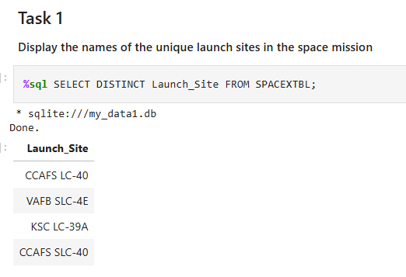
4. Results – 4.EDA with SQL
TASK 1: Display the names of the unique launch sites in the space mission
Launch_Site
CCAFS LC-40
VAFB SLC-4E
KSC LC-39A
CCAFS SLC-40

Slide 20
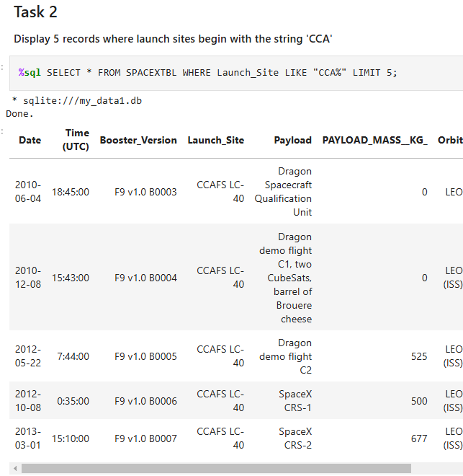
4. Results – 4.EDA with SQL
Task 2
Display 5 records where launch sites begin with the string 'CCA'

Slide 21
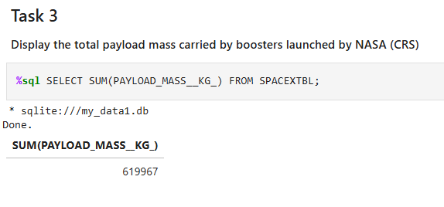
4. Results – 4.EDA with SQL
Task 3
Display the total payload mass carried by boosters launched by NASA (CRS)
The sum of total payload mass carried by boosters which were launched by NASA is: 619967.

Slide 22
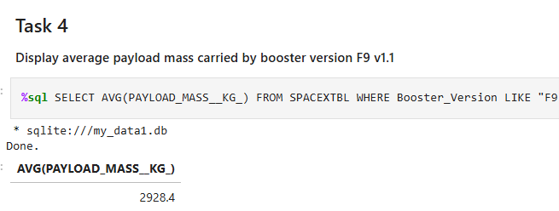
4. Results – 4.EDA with SQL
Task 4
Display average payload mass carried by booster version F9 v1.1
The average payload mass carried by booster version which like “F9 v1.1” is: 2928.4

Slide 23
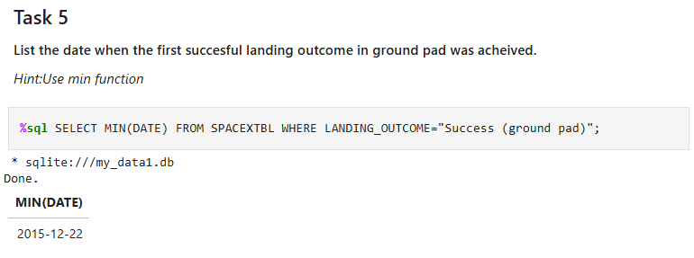
4. Results – 4.EDA with SQL
Task 5
List the date when the first succesful landing outcome in ground pad was acheived.

Slide 24
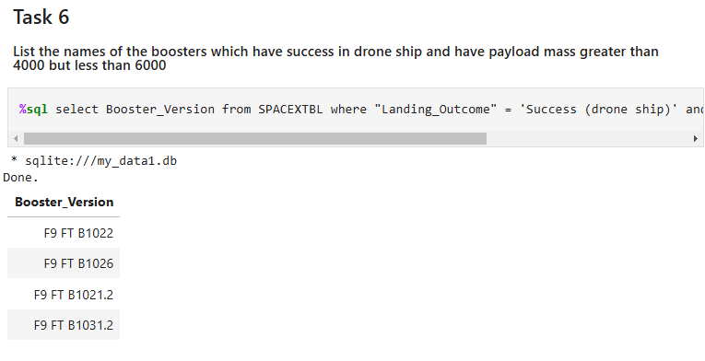
4. Results – 4.EDA with SQL
Task 6
List the names of the boosters which have success in drone ship and have payload mass greater than 4000 but less than 6000

Slide 25
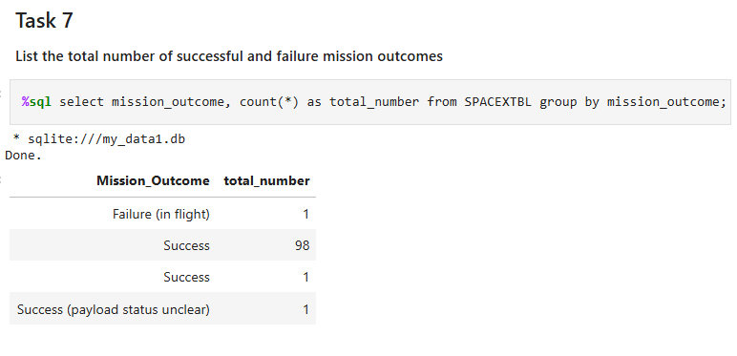
4. Results – 4.EDA with SQL
Task 7
List the total number of successful and failure mission outcomes

Slide 26
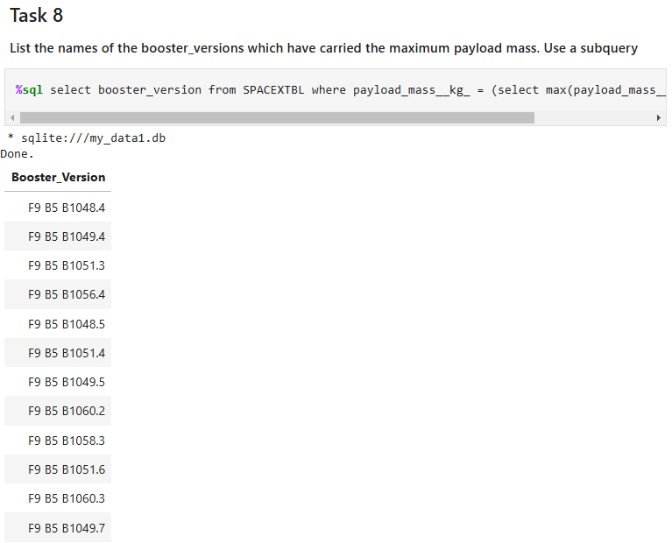
4. Results – 4.EDA with SQL
Task 8
List the names of the booster_versions which have carried the maximum payload mass. Use a subquery

Slide 27
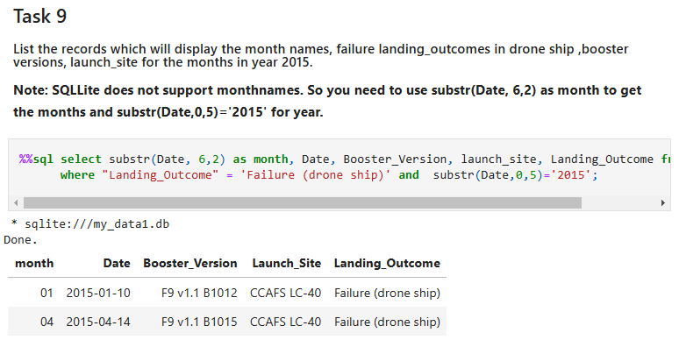
4. Results – 4.EDA with SQL
Task 9
List the records which will display the month names, failure landing_outcomes in drone ship ,booster versions, launch_site for the months in year 2015.

Slide 28
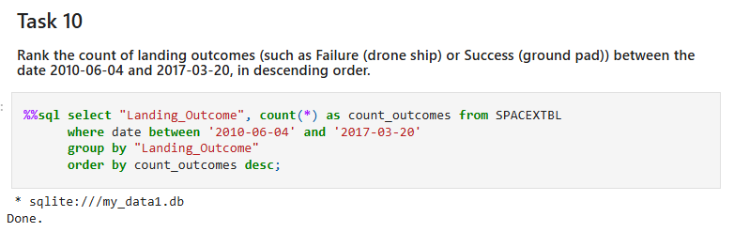
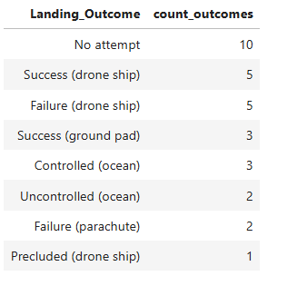
4. Results – 4.EDA with SQL
Task 10
Rank the count of landing outcomes (such as Failure (drone ship) or Success (ground pad)) between the date 2010-06-04 and 2017-03-20, in descending order.

Slide 29
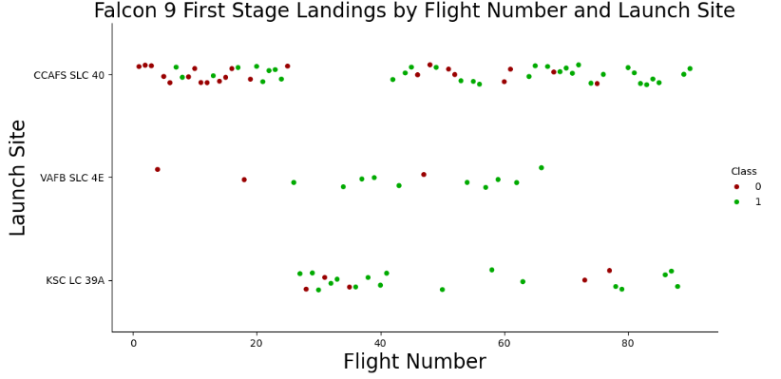
4. Results – 5.EDA Visualization
TASK 1: Visualize the relationship between Flight Number and Launch Site
The earliest lights all failed while the latest lights all succeeded.
The CCAFS SLC 40 launch site has about a half of all launches.
VAFB SLC 4E and KSC LC 39A have higher success rates.
It can be assumed that each new launch has a higher rate of success.

Slide 30
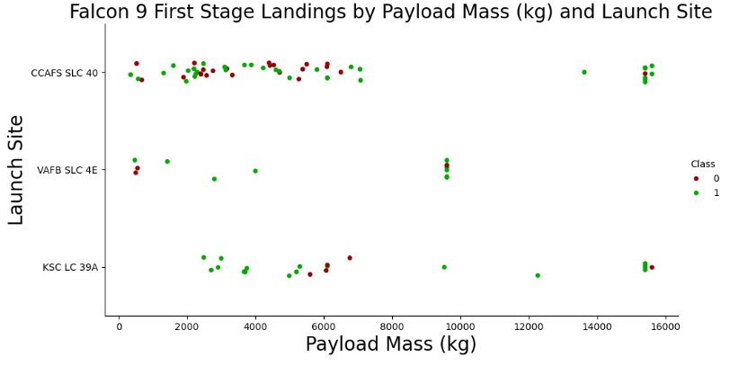
4. Results – 5.EDA Visualization
TASK 2: Visualize the relationship between Payload Mass and Launch Site
For every launch site the higher the payload mass, the higher the success rate.
Most of the launches with payload mass over 7000 kg were successful.
KSC LC 39A has a 100% success rate for payload mass under 5500 kg too.

Slide 31
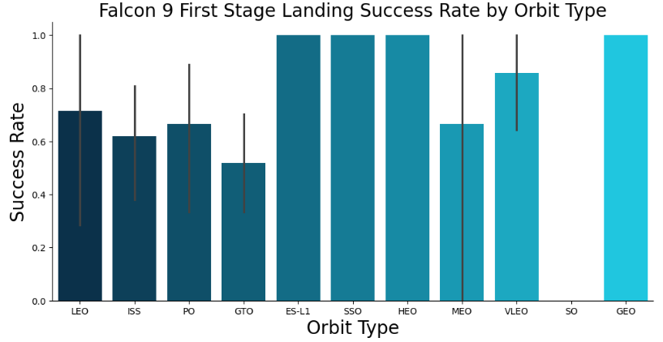
4. Results – 5.EDA Visualization
Task3: Visualize the relationship between success rate of each orbit type
Orbits with 100% success rate: - ES-L1, GEO, HEO, SSO
Orbits with 0% success rate: - SO
Orbits with success rate between 50% and 85%: - GTO, ISS, LEO, MEO, PO

Slide 32
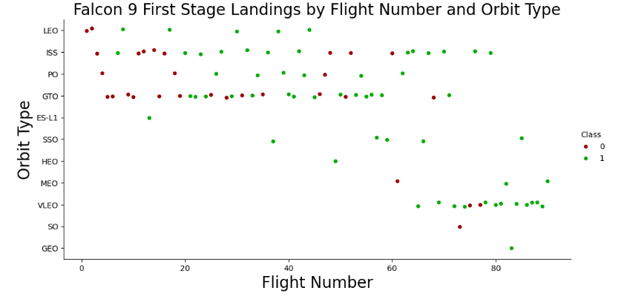
4. Results – 5.EDA Visualization
Task4: Visualize the relationship between Flight Number and Orbit type
Orbits with 100% success rate: - ES-L1, GEO, HEO, SSO
Orbits with 0% success rate: - SO
Orbits with success rate between 50% and 85%: - GTO, ISS, LEO, MEO, PO

Slide 33
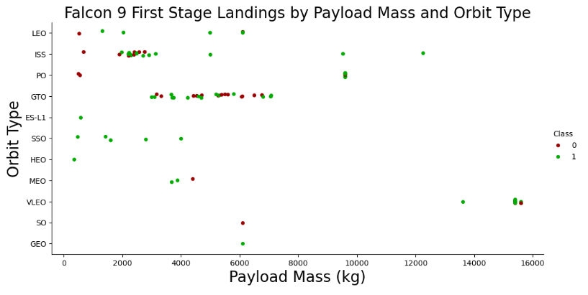
4. Results – 5.EDA Visualization
TASK 5: Visualize the relationship between Payload Mass and Orbit type
Heavy payloads have a negative influence on GTO orbits
positive on GTO and Polar LEO (ISS) orbits.

Slide 34
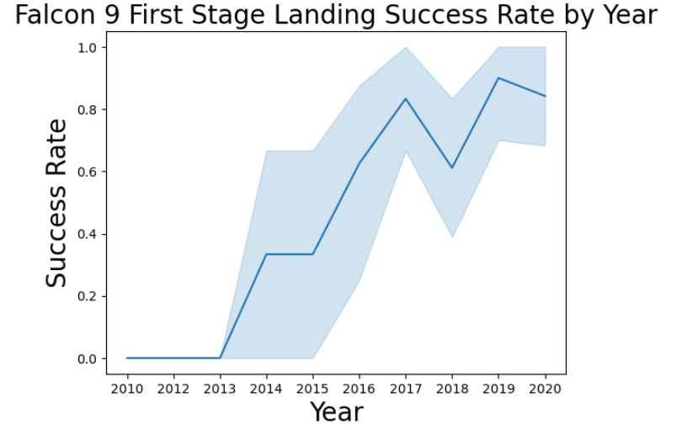
4. Results – 5.EDA Visualization
TASK 6: Visualize the launch success yearly trend
The success rate since 2013 kept increasing till 2020.
The success rate has a significant decrease on 2018.

Slide 35
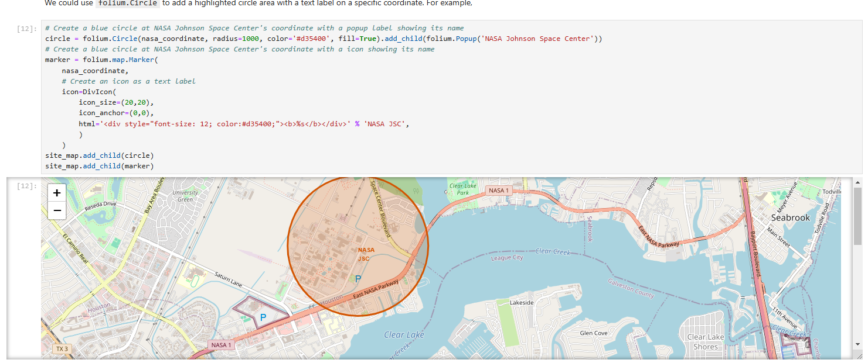
4. Results – 6. Sites Locations Analysis with Folium
Task 1: Mark all launch sites on a map
From the given .csv file, we can find the latitude and longitude for each site.
Using folium.Circle() to create the area on the displayed map.

Slide 36
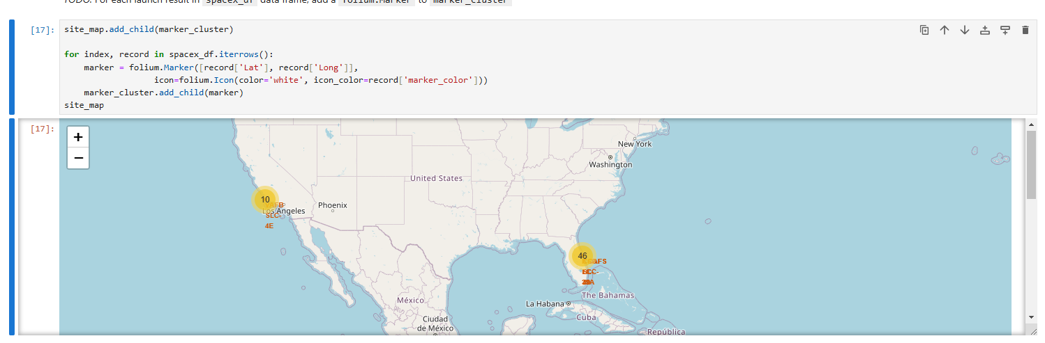
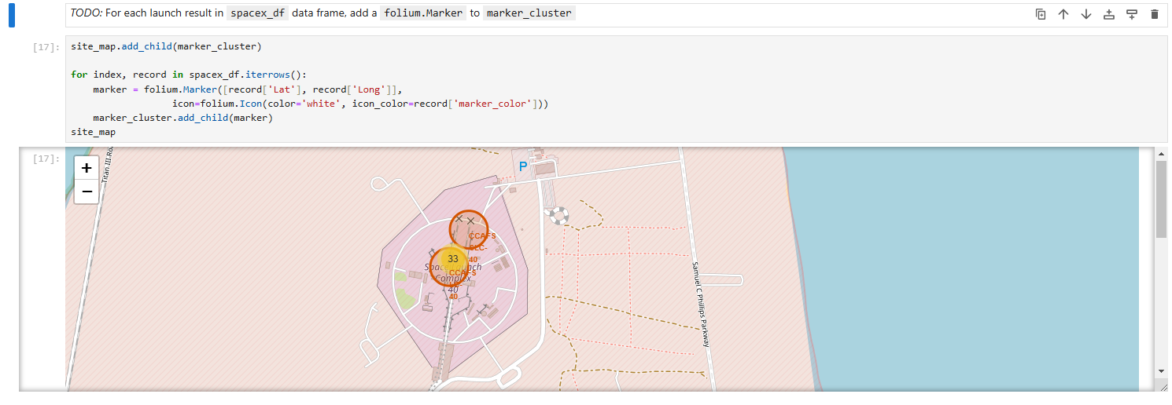
4. Results – 6. Sites Locations Analysis with Folium
Task 2: Mark the success/failed launches for each site on the map
Create a new column in the dataframe called marker_color to store the marker colors based on the class value.
For each launch result in spacex_df data frame, add a folium.Marker to marker_cluster.

Slide 37
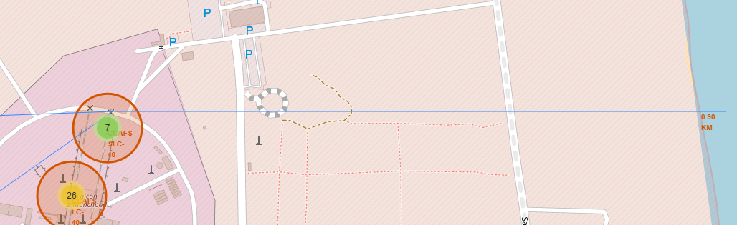

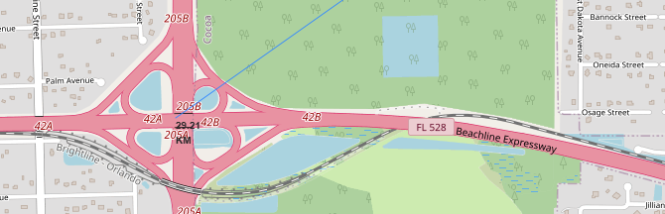
4. Results – 6. Sites Locations Analysis with Folium
TASK 3: Calculate the distances between a launch site to its proximities
Add a MousePosition on the map to get coordinate for a mouse over a point on the map.
Draw a PolyLine between a launch site to the selected coastline point

Slide 38
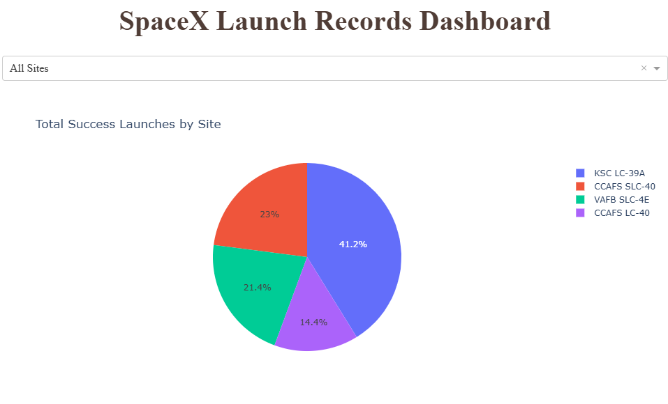
4. Results – 7.Dashboard with Ploty Dash
TASK 1: Add a Launch Site Drop-down Input Component
For 4 different launch sites, this task implement a dropdown menu.
The options is the list for all 4 launch sites.
There are also some other attributes for the plots.

Slide 39
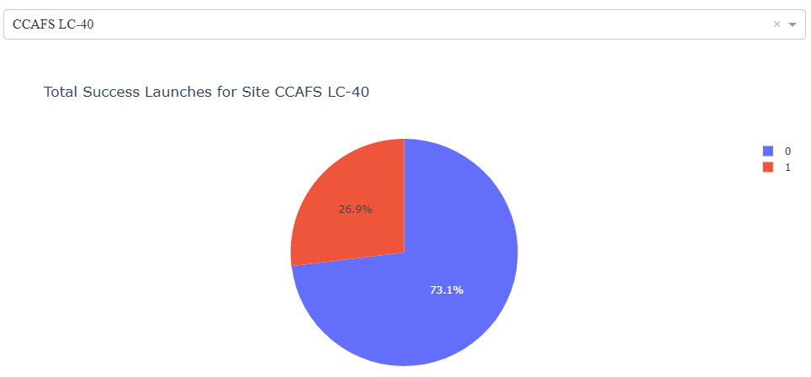
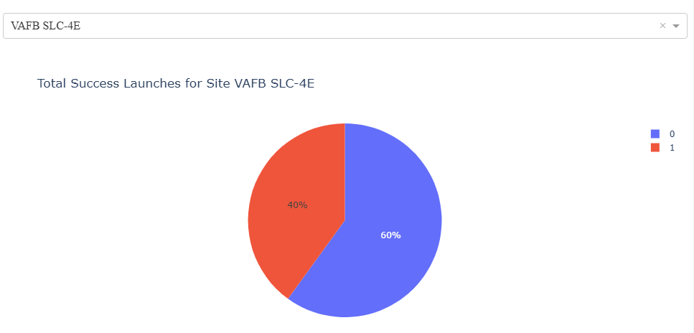
4. Results – 7.Dashboard with Ploty Dash
TASK 2: Add a callback function to render success-pie-chart based on selected site dropdown
For 4 different launch sites, this task implement a dropdown menu.
The options is the list for all 4 launch sites.
There are also some other attributes for the plots.

Slide 40
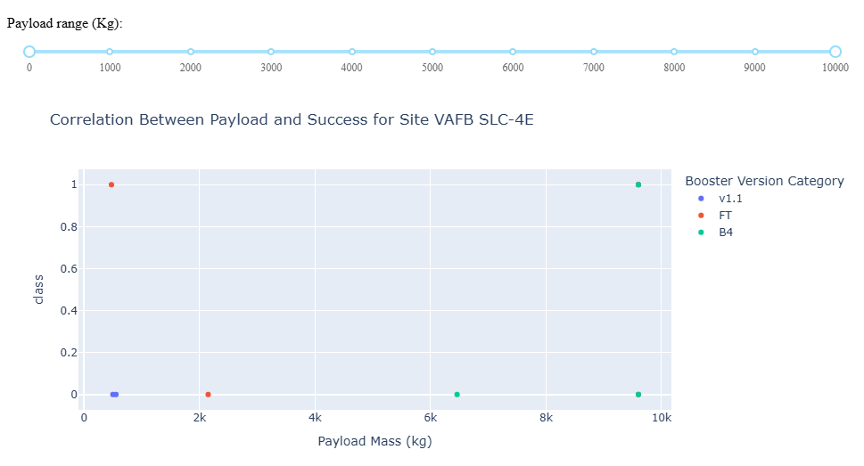
4. Results – 7.Dashboard with Ploty Dash
TASK 3: Add a Range Slider to Select Payload
TASK 4: Add a callback function to render the success-payload-scatter-chart scatter plot
The range slider is to find if variable payload is correlated to mission outcome.
It is also to color-label the Booster version on each scatter point so that we may observe mission outcomes with different boosters.

Slide 41
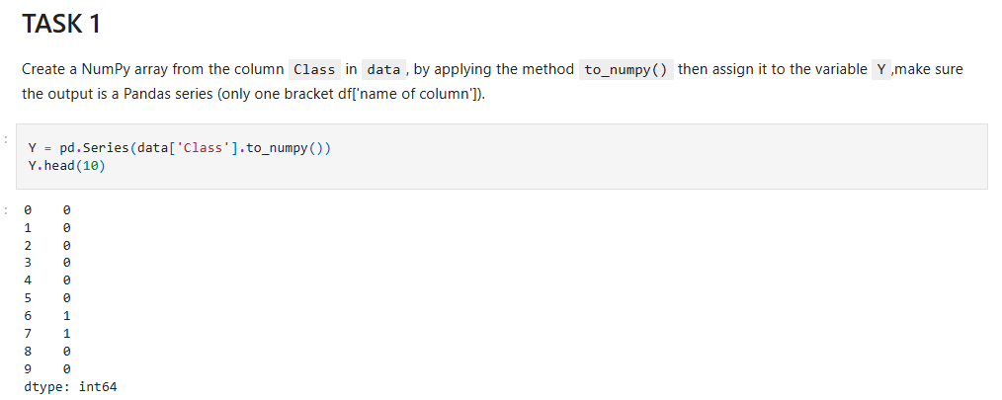
4. Results – 8. ML Prediction
TASK 1: Create a NumPy array from the column Class in data.
By applying the method to_numpy() then assign it to the variable Y.
The output is a Pandas series (only one bracket df['name of column']).

Slide 42
4. Results – 8. ML Prediction
TASK 1: Create a NumPy array from the column Class in data.
By applying the method to_numpy() then assign it to the variable Y.
The output is a Pandas series (only one bracket df['name of column']).

Slide 43
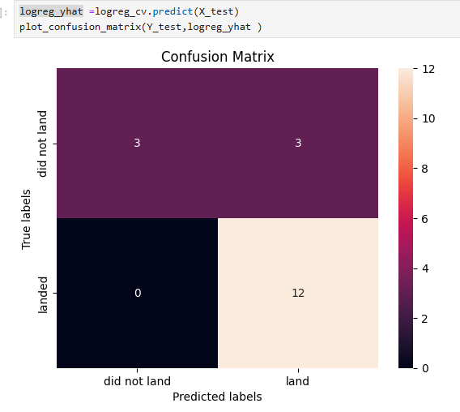
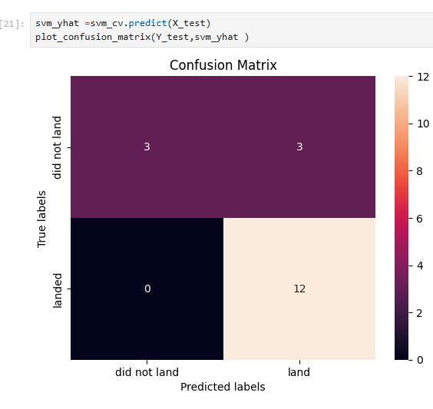
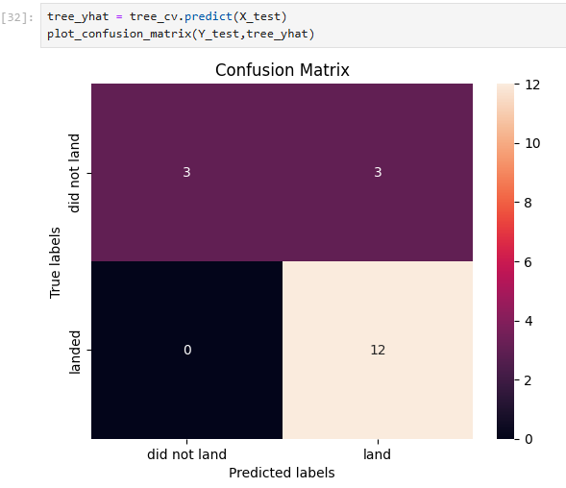
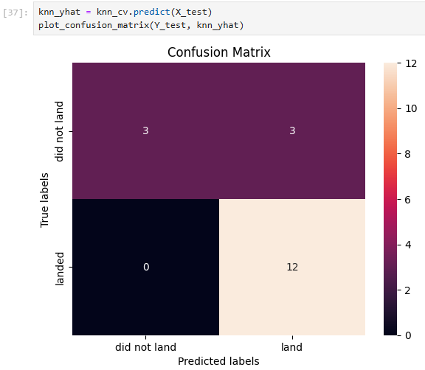
4. Results – 8. ML Prediction
TASK 5-11: Calculate the accuracy of 4 methods and plot their confusion matrix.
Confusion Matrix: Examining the confusion matrix, we see that logistic regression can distinguish between the different classes. We see that the major problem is false positives.
Using 4 methods(Logistic Regression, SVM, Decision Tree, KNN), first train their best parameters. Plot the confusion matrix using plot_confusion_matrix().
We can see that these 4 methods has no difference under these comparison.

Slide 44
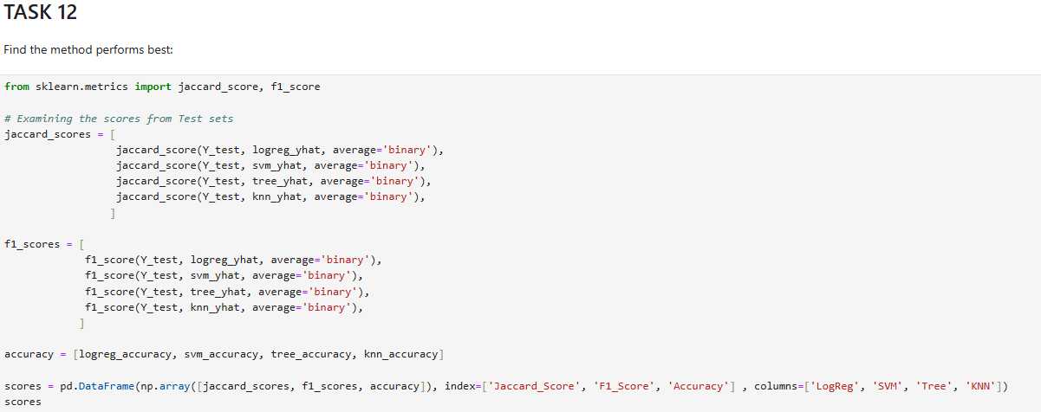
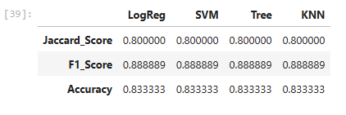
4. Results – 8. ML Prediction
TASK 12-1: Find the method performs best:
We plot the scores from test sets based on the 4 methods.
We can see from the results that these 4 methods have no difference on Training set. So we can try the methods on Whole data.

Slide 45
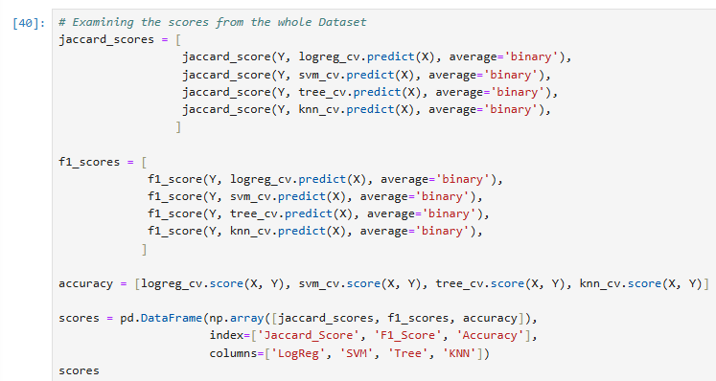
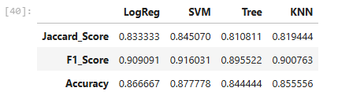
4. Results – 8. ML Prediction
TASK 12-2: Find the method performs best:
we can try the methods on Whole data.
Based on the scores and accuracies on the whole dataset, we can conclude that the SVM has the best score among the 4 methods.

Slide 46
5. Conclusion

Slide 47
Conclusion
Launches with a low payload mass show better results than launches with a larger payload mass.
SpaceX’s record for Falcon 9 first stage landing outcomes has improved.
The trend is toward better performance and greater success as more launches are made.
The machine learning models can be used to predict future SpaceX Falcon 9 first stage landing outcomes.
Most of launch sites are in proximity to the Equator line and all the sites are in very close proximity to the coast.
The success rate of launches increases over the years.
KSC LC-39A has the highest success rate of the launches from all the sites.
Orbits ES-L1, GEO, HEO and SSO have 100% success rate.
SVM is the best algorithm for this dataset.

Slide 48
Appendix
Special Thanks to:
Instructors
Coursera
IBM

Slide 49
Thank you for watching!

